Slide 1
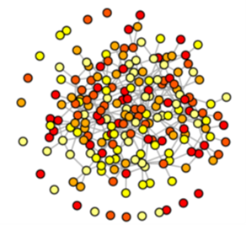



Introduction to Networks
Robin A. Choudhury
garrettlab.com
@Garrett_Lab
@rob_choudhury

Slide 2
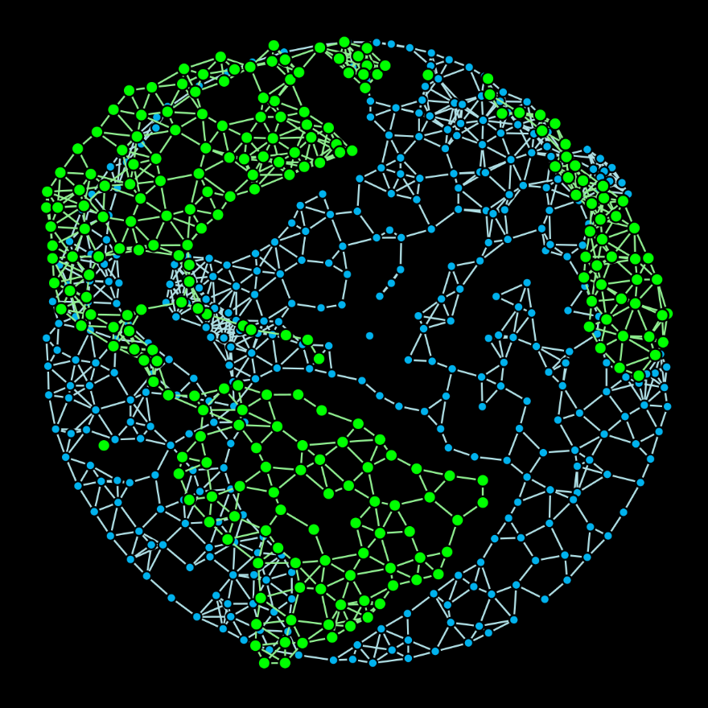
Learning Goals
Understand some general concepts related to network analysis, with applications in…
Epidemics
Crop Breeding
Trade
Microbiomes
And more

Slide 3

Pieces of a Network
Node
(Vertex)
Link
(Edge)

Slide 4
Traits of Network Nodes
In a socioeconomic network, nodes are people or human institutions (managers/farmers, extension agents, scientists, …)
In a biophysical network, nodes are geographic locations (individual plants, farms, storage facilities, wildlands, …)
Node
(Vertex)

Slide 5
Traits of Network Links
In a socioeconomic network, links are transmission of information, goods, or money.
In a biophysical network, links are transmission of inoculum, infested seed material, and vectors.
Link
(Edge)

Slide 7
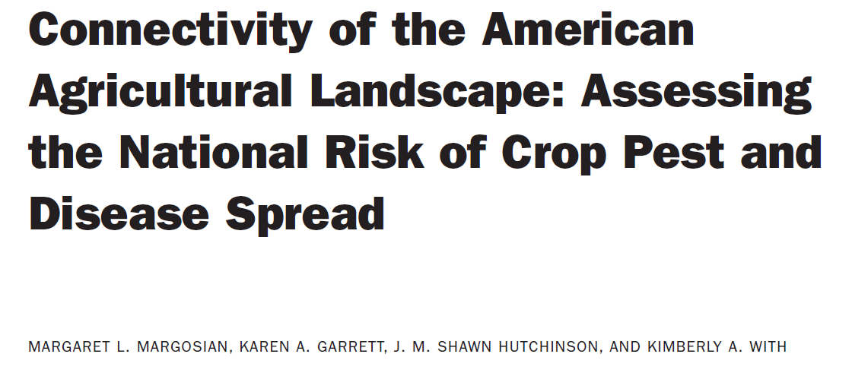
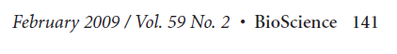
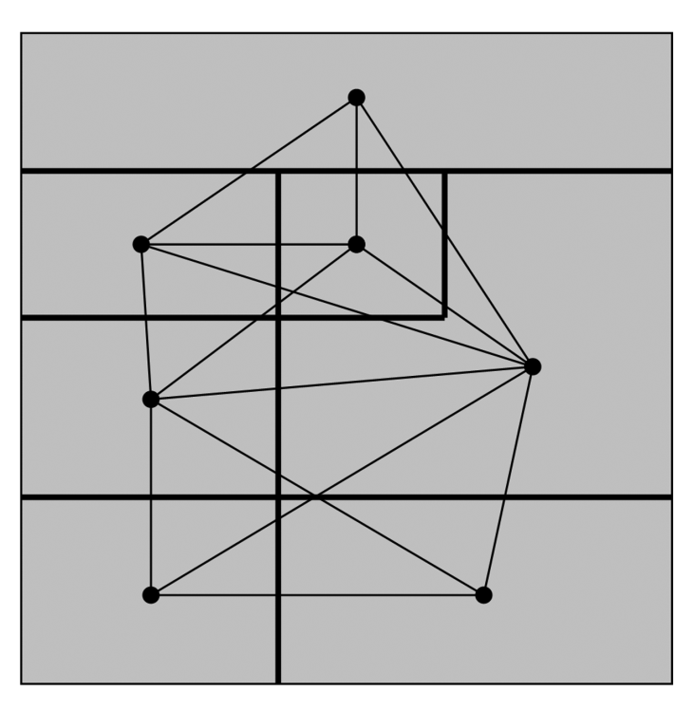


Peg Margosian
Nodes: US counties
Links: measures of likelihood of pathogen movement based on host abundance

Slide 8
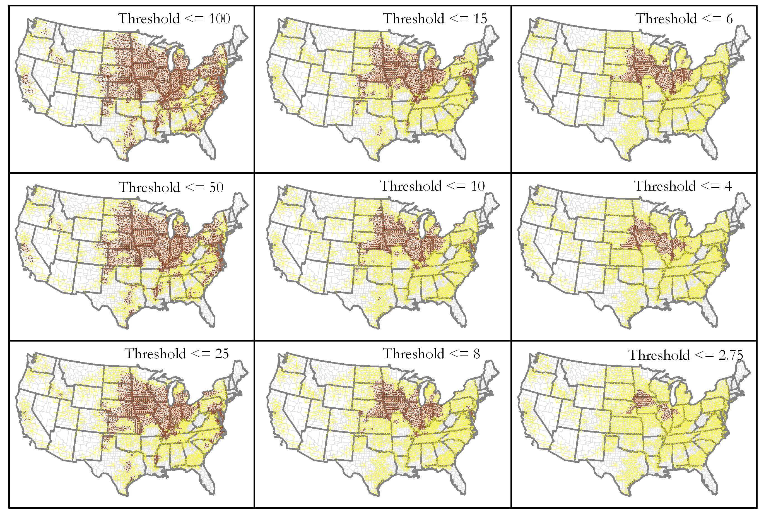
Maize
Red = connected areas for pathogens that require at least low maize density to spread
Red = connected areas for pathogens that require high maize density to spread

Slide 9
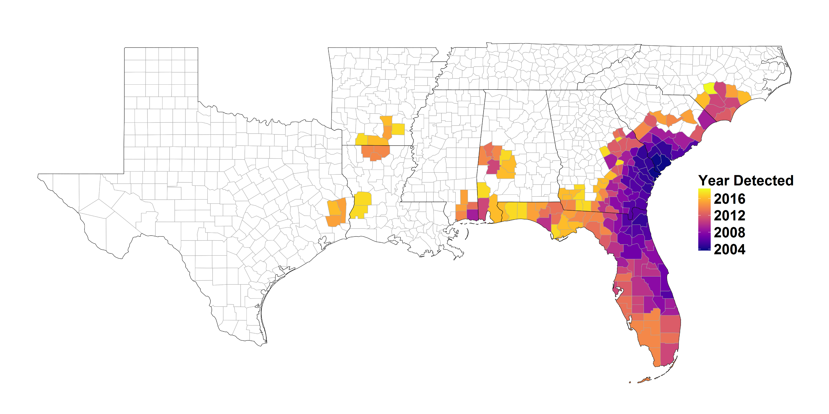
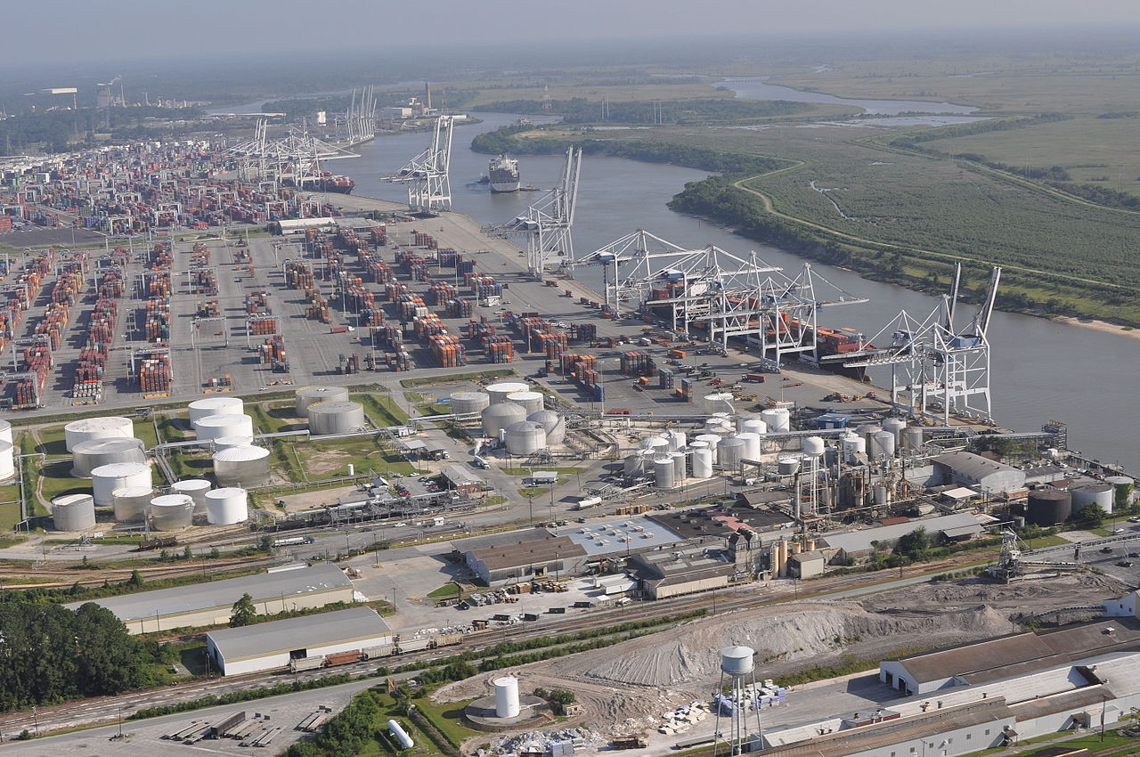
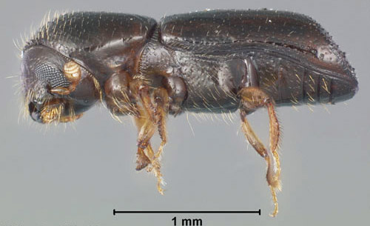
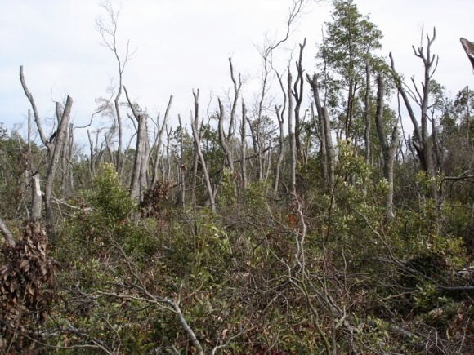
Laurel Wilt Disease
2002
USDA-FS
Port Wentworth near the port of Savannah from Asia
USDA-FS
2004

Slide 10





Epidemic network analysis for mitigation of invasive pathogens in seed systems: Potato in Ecuador
Phytopathology 2017
C. E. Buddenhagen*, J. F. Hernandez Nopsa*, K. F. Andersen, J. Andrade-Piedra, G. A. Forbes, P. Kromann, S. Thomas-Sharma, P. Useche, K. A. Garrett

Slide 11
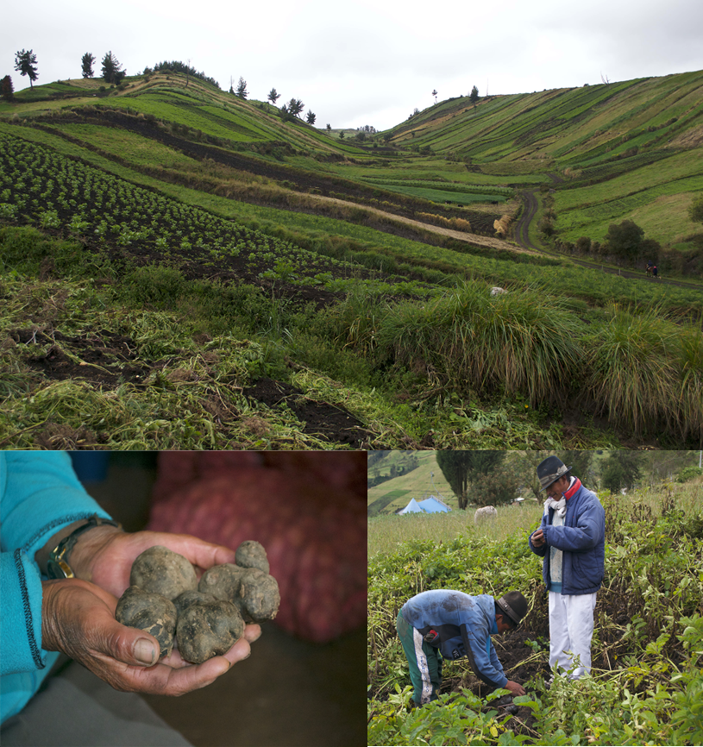
Potato production in Tungurahua Province, Ecuador
Photos: J Hernandez Nopsa
In this analysis, we have survey data for both potato transactions and sources of information for IPM

Slide 12
Scenario analysis indicating how effective monitoring of the spread of a pathogen would be at each node, based on location in network and IPM information sources
Buddenhagen, Hernandez Nopsa, et al. 2017

Slide 13
Phytopathology 2017
Cassava breeding network

Slide 14
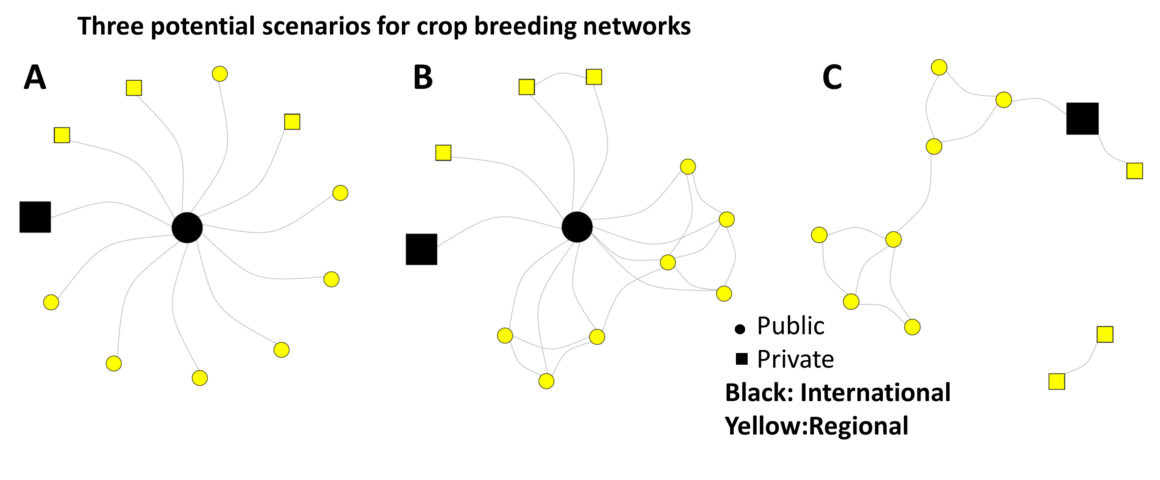
International public breeding group is central hub and bridge node between regional groups
International public breeding group is central hub, but with connections between regional groups
Fragmentation of the network without a central international public breeding group

Slide 15
Can global crop breeding networks adapt to new disease challenges under global change?
Garrett et al 2017

Slide 16

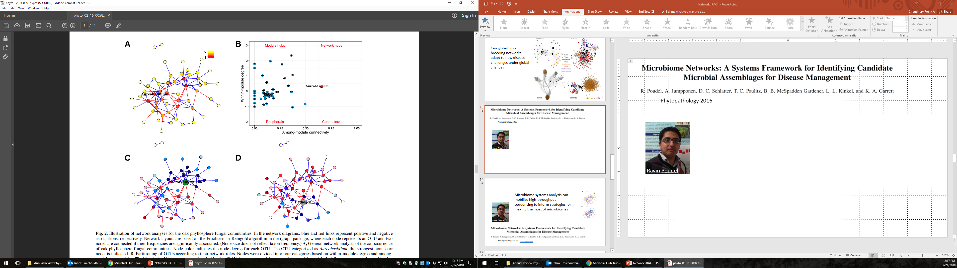
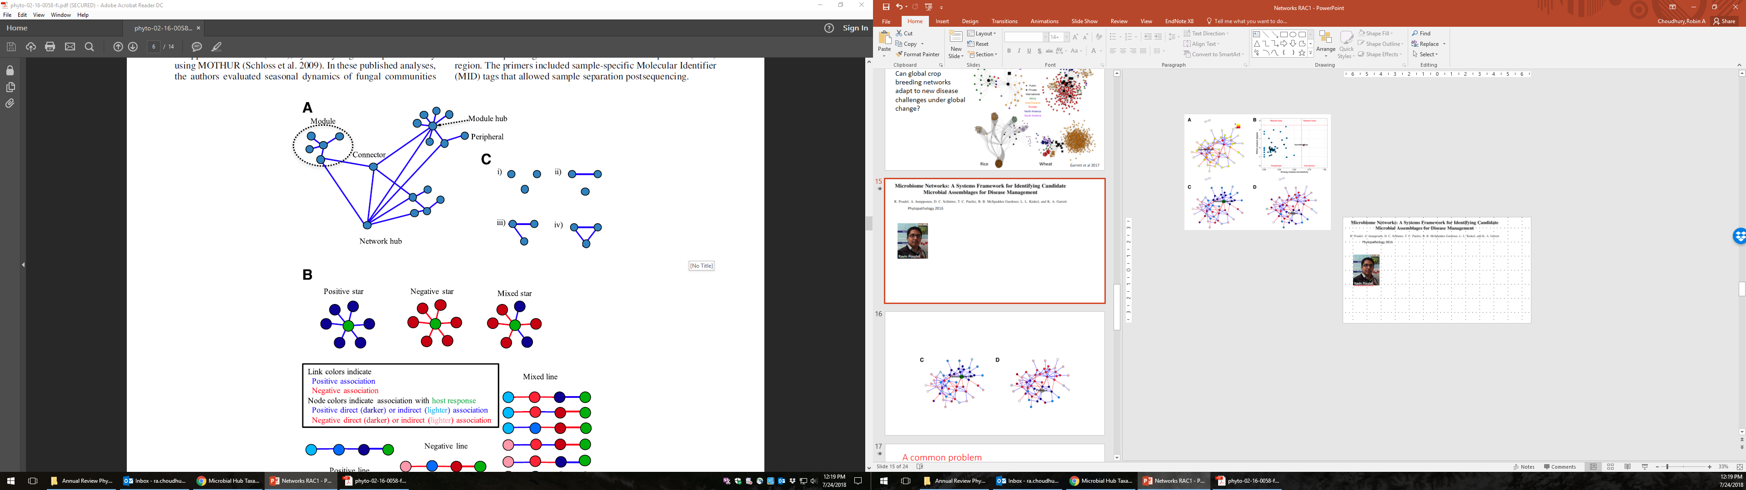
Phytopathology 2016
Ravin Poudel

Slide 17
How do pathogen and host variables affect the microbiomes of plants?
host variables
pathogen variables

Slide 18
How do microbes interact both within and between kingdoms?

Slide 20
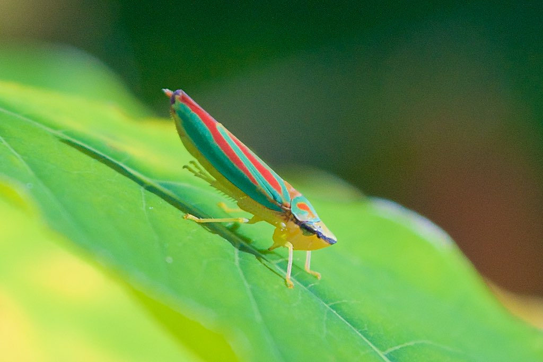
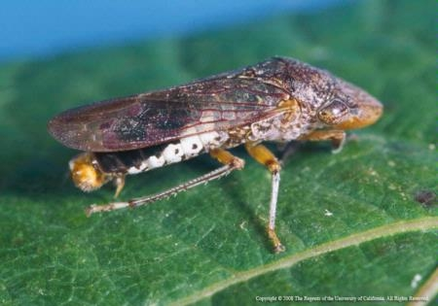
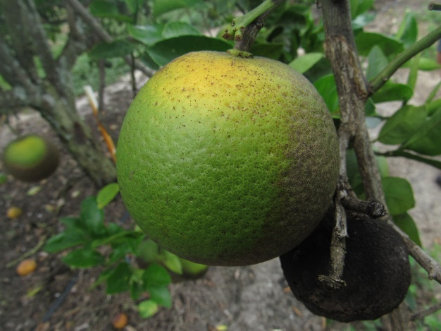
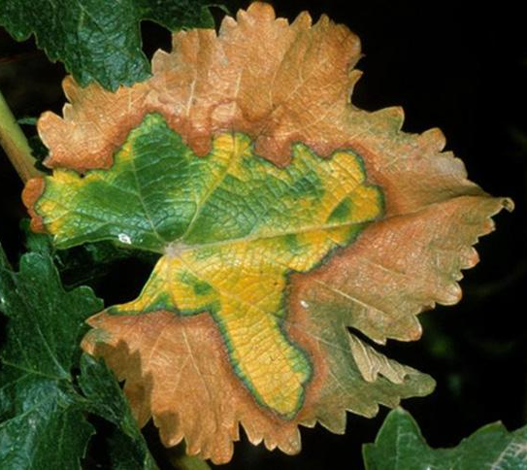
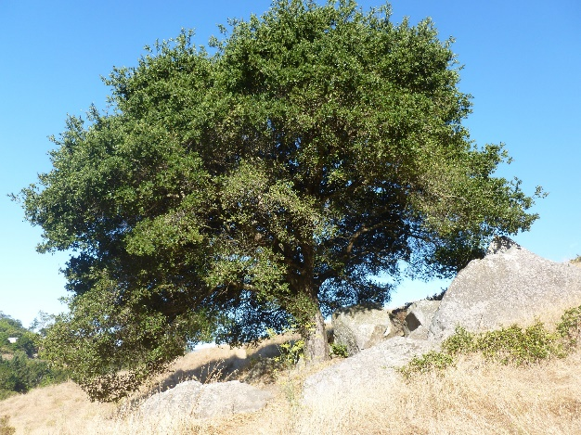

Slide 23
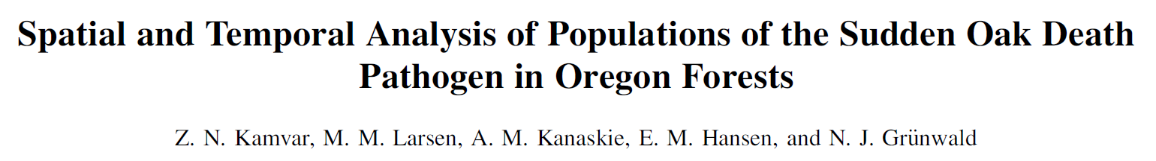

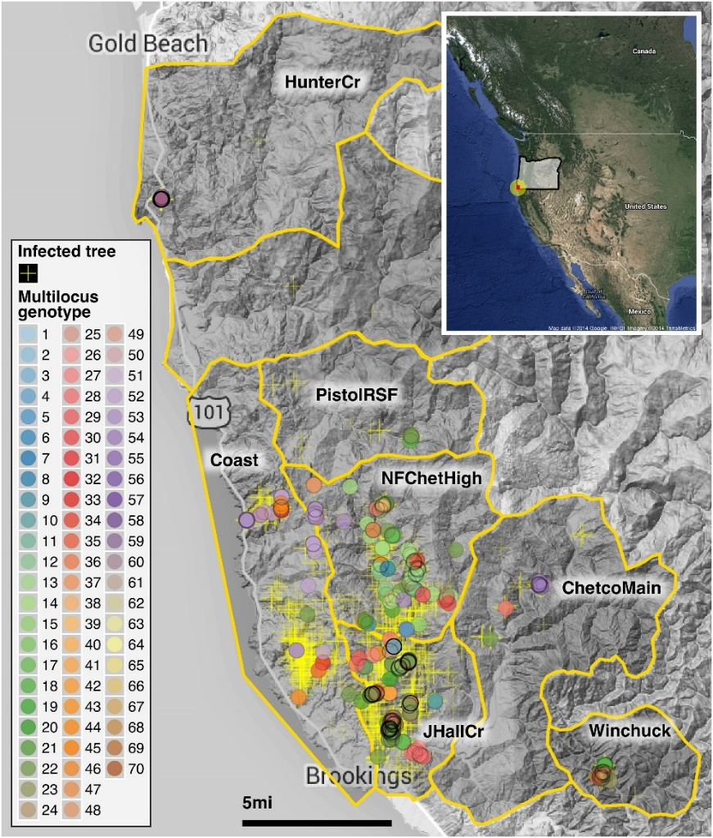
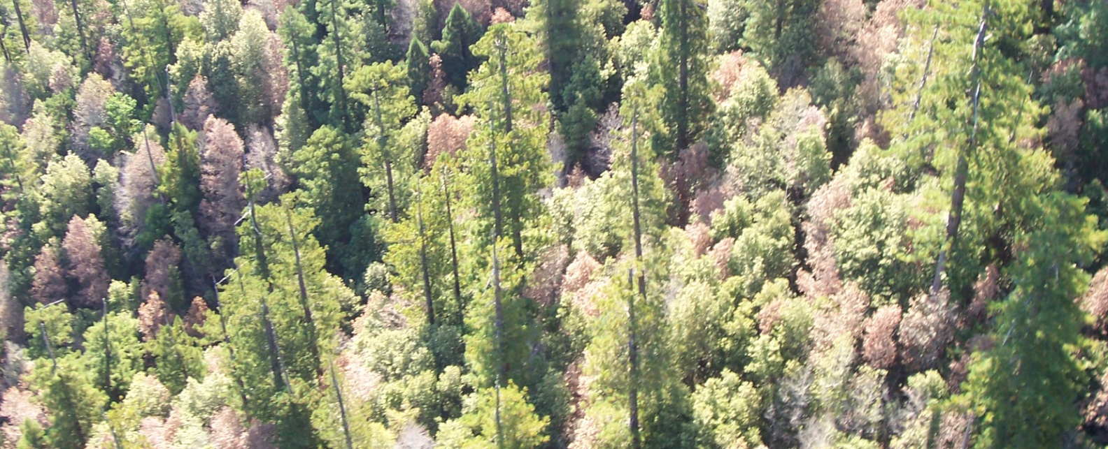

Slide 24
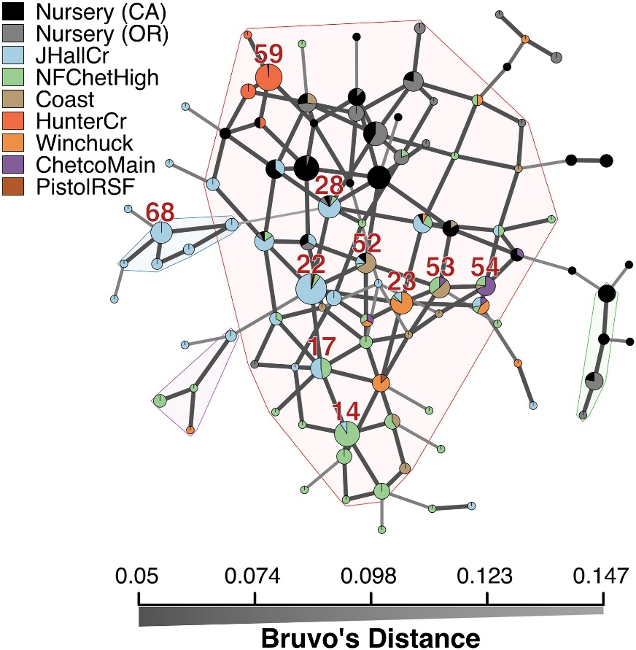
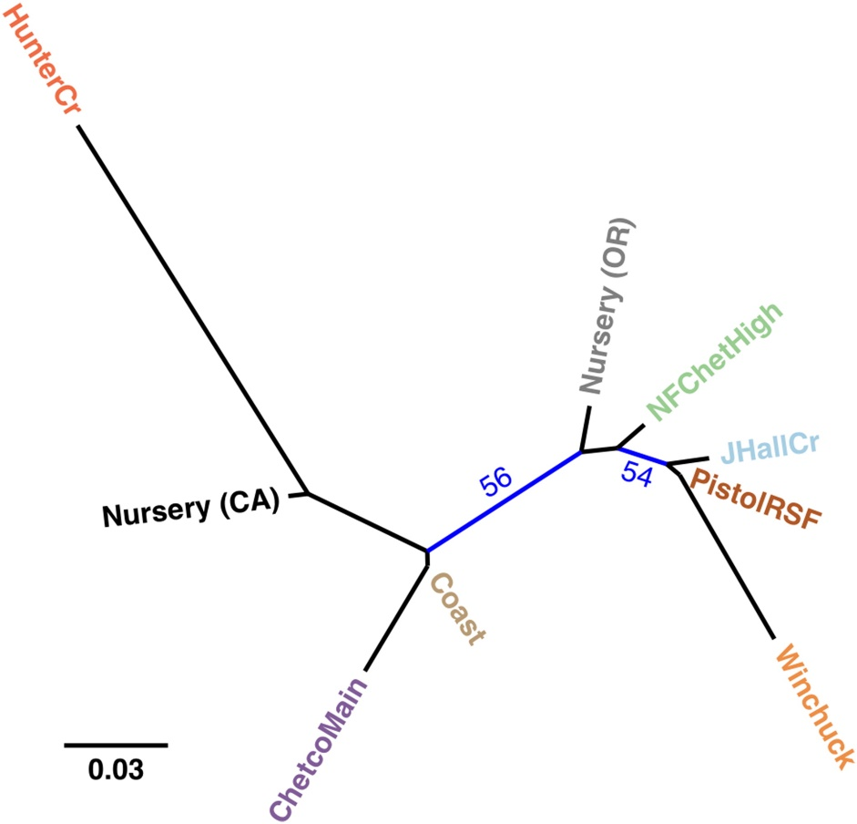

Slide 25
A common problem in pest or disease management
A management concept or technology may work well in an experiment, but…
How well do we really understand its performance across a region?
Will a critical mass of people learn about it and adopt it?
Will the "management landscape" slow invasions enough to protect production?
And suppose climate change or a new pest type alter the system dynamics…?
System analysis can address this problem by identifying priorities for successful regional management

Slide 26
Impact network analysis (INA)
The Garrett Lab is developing INA as a platform for evaluating system management strategies (such as crop breeding networks, seed systems, and integrated pest and disease management)
Impact OF research products such as information/training, disease resistance, and disease-free seed production technologies
Impact ON spatial ecological processes, such as gene/genotype spread, pathogen invasions or ecosystem services more broadly
Impact THROUGH communication and decision-making networks, and linked biophysical networks
Notes:
good

Slide 27
Impact Network Analysis
Biophysical Network
Social Network

Slide 28
Impact Network Analysis
Biophysical Network
Social Network
Notes:
Plants and people

Slide 29
Impact Network Analysis
Biophysical Network
Social Network

Slide 30
Impact Network Analysis
Biophysical Network
Social Network

Slide 31
Impact Network Analysis
Biophysical Network
Social Network

Slide 32
Impact Network Analysis
Biophysical Network
Social Network

Slide 33
Impact Network Analysis
Biophysical Network
Social Network

Slide 34
Impact Network Analysis
Biophysical Network
Social Network

Slide 35
Impact Network Analysis
Biophysical Network
Social Network

Slide 36
Impact Network Analysis
Biophysical Network
Social Network

Slide 37
Impact Network Analysis
Biophysical Network
Social Network

Slide 38
Impact Network Analysis
Biophysical Network
Social Network

Slide 39
Impact Network Analysis
Biophysical Network
Social Network

Slide 40
Impact Network Analysis
Biophysical Network
Social Network

Slide 41
Impact Network Analysis
Biophysical Network
Social Network

Slide 42
Impact Network Analysis
Biophysical Network
Social Network

Slide 43
Impact Network Analysis
Biophysical Network
Social Network

Slide 44

Lots of Uses of Network Models in Plant Pathology

